Slide 1


«Monitoring system of plant pollution»
«Green Planet»
Student of 12th grade: Balgabay Shyngysbek
Teacher: Mukanova Makpal, Bessenbayeva Gulmira

Slide 2
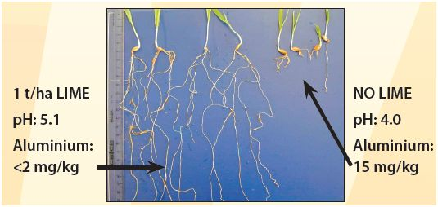
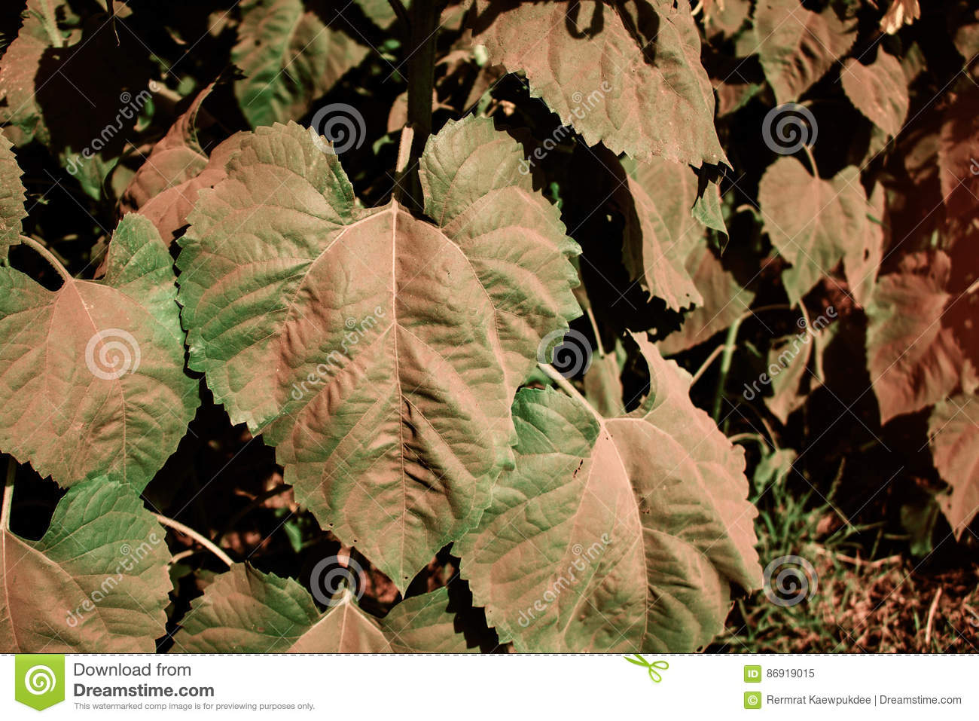
Plant pollution
A lack of light due to a thick dust in the air
Drought because of “Global Warming”(a lot of creatures that consume oxygen, 7.9 billion people[the figure is taken from (https://www.worldometers.info/world-population/)
Air pollution with harmful gases(flue gases, metan, propane, butane, concentration of liquefied petroleum gas, and coke gas in the environment)
Soil acidity (sulfuric acid in air)

Slide 3
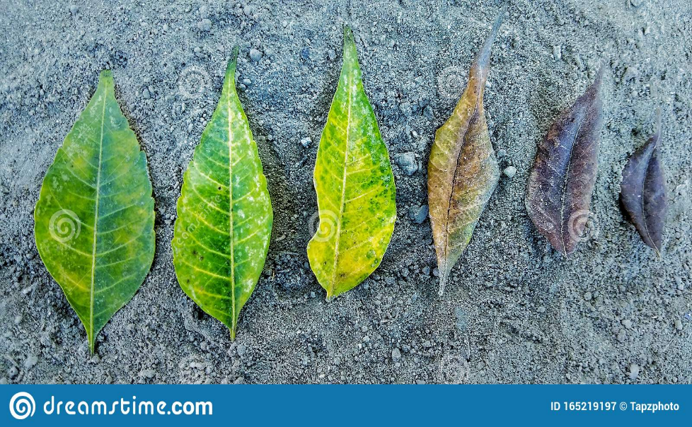
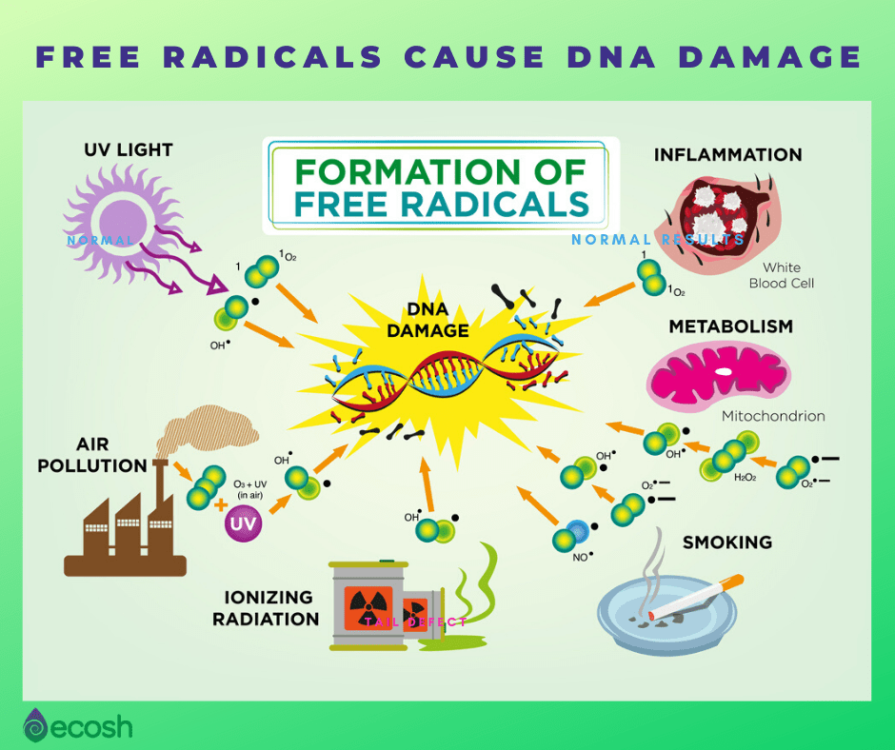
Consequences of plant pollution
Reduction of leaf life
Violation of redox processes in plants
A decrease in the productivity of plants
Bloom shifts
A premature falls of foliage
Decreased enzyme activity
Harmful substances eaten by human(new diseases, frequent illnesses, poisoning)
The picture is taken from https://cutt.ly/7EysI6i
More information is on https://gazetasadovod.ru/veg/5786-vrednye-gazy-dlya-rasteniy.html
The picture is taken from https://cutt.ly/TEY9bT1

Slide 4
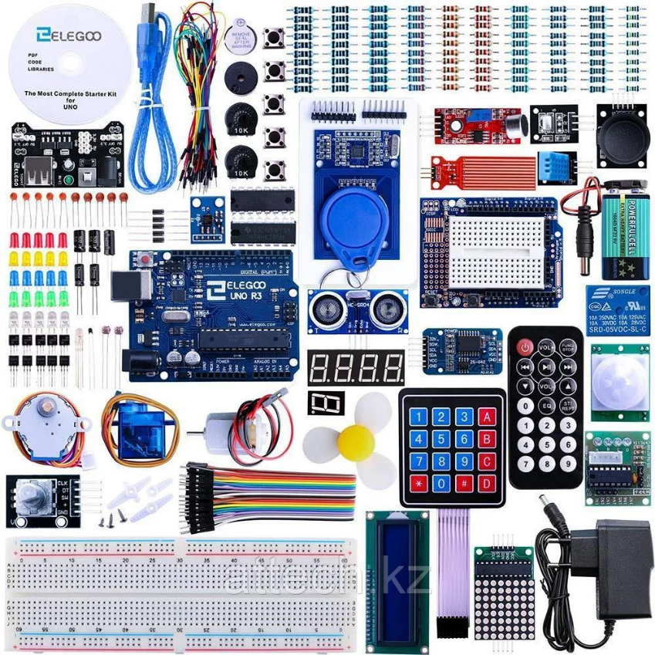
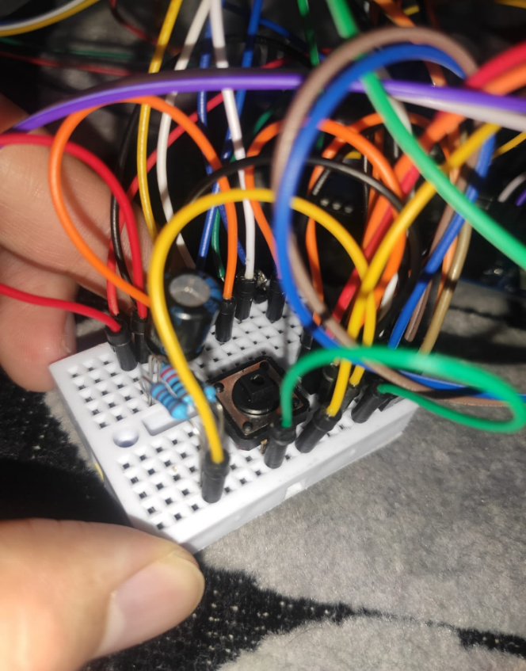
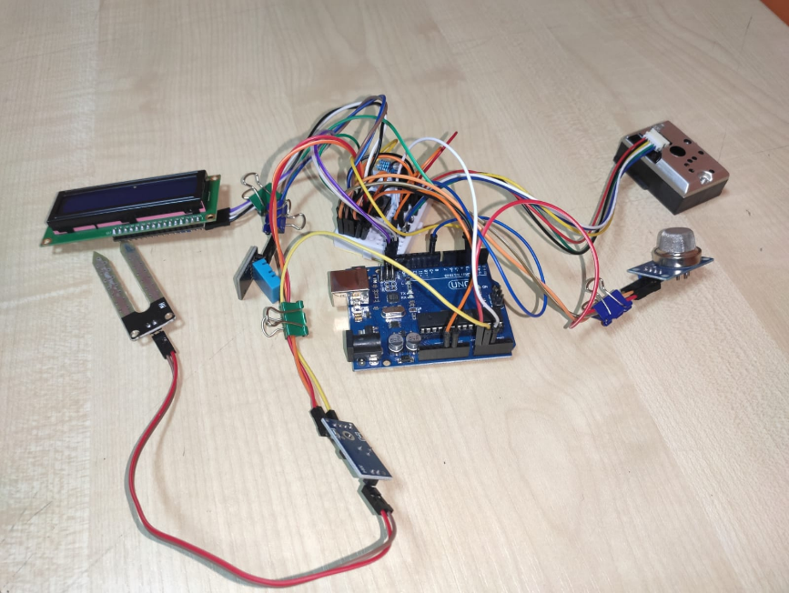
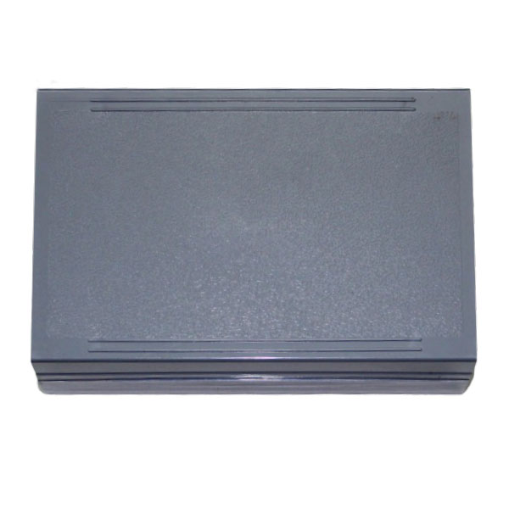
Solution
Universal
Inexpensive
Accessible
Programming ease
IDE works on any operating system
Open source in software
Open source in hardware

Slide 5

The result in an open form
Plastic box 120*80*40 mm

Slide 6
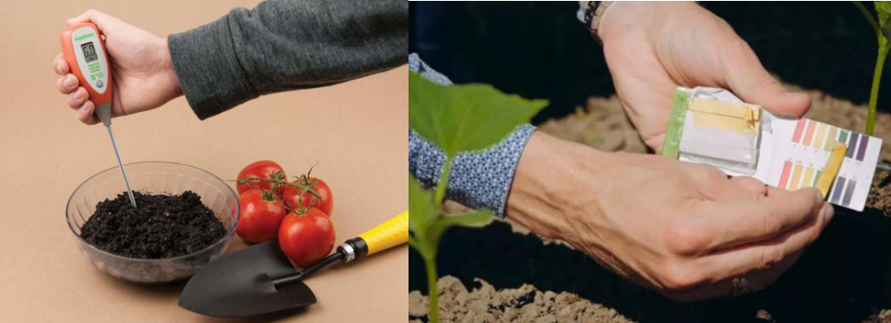
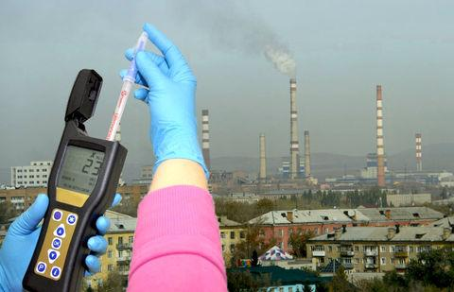
Benefits of the Project
Environment: prevents plants' pollution
Education: Teachers can provide demonstration of practical work in classes for pupils as a “lesson objective”
Investigation: Allows for scientists to economize their time during their research work
Economy: Own Product of Kazakhstan

Slide 7
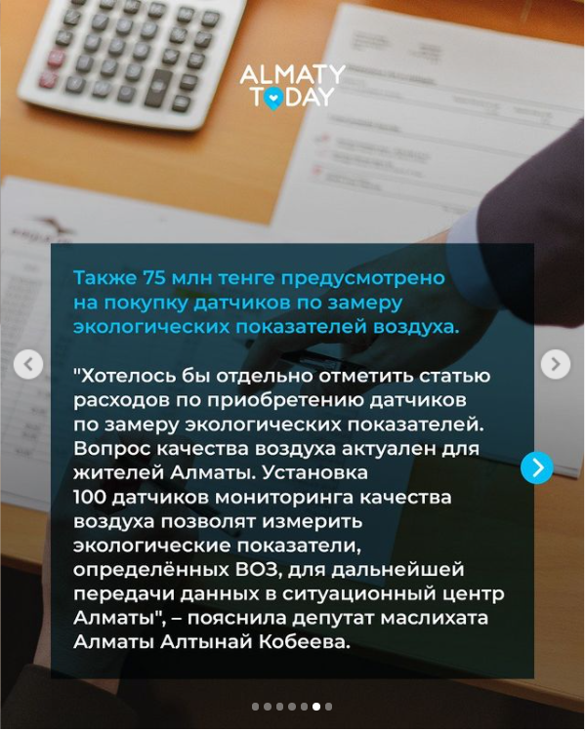
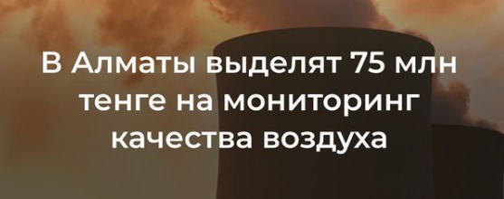
Financial Cost
Deputies of the Maslikhat of Almaty approved amendments to the city budget and distributed 37.2 billion tenge. It took them 15 minutes. Without clarification or criticism, the people's representatives voted "for" unanimously. 27.08.2021 @almaty.today
The information is taken from https://www.instagram.com/p/CTE-IyUNGnM/?utm_medium=copy_link and proved by https://informburo.kz/novosti/deputaty-raspredelili-372-mlrd-byudzetnyx-tenge-dengi-vydeleny-v-tom-cisle-na-podderzku-priyutov-otlovlennyx-kosek

Slide 8

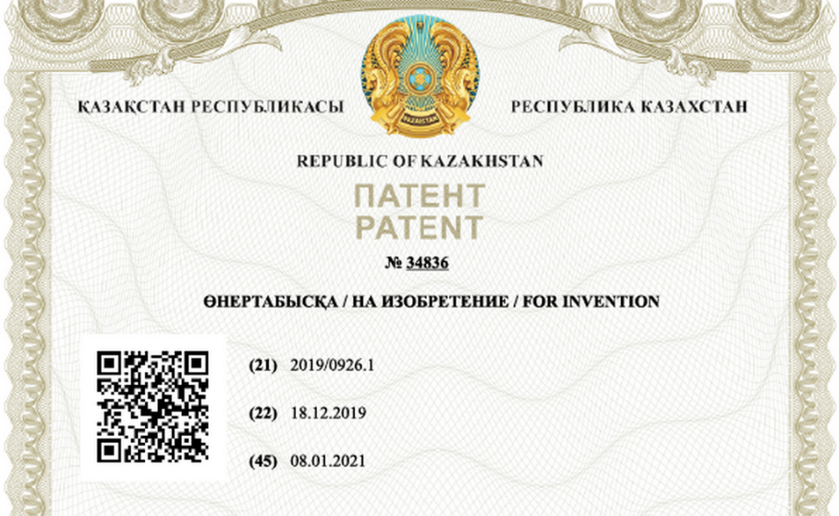
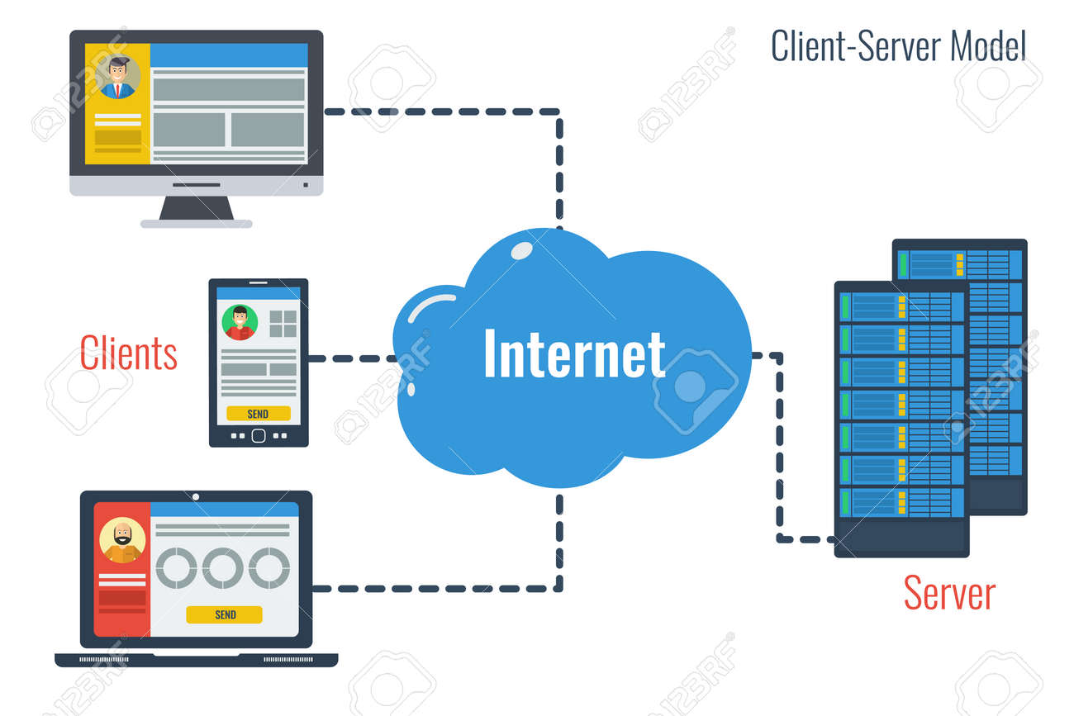
Future plans
Internet
Monitoring System of plant pollution
Internet
Client

Slide 9


